Slide 1
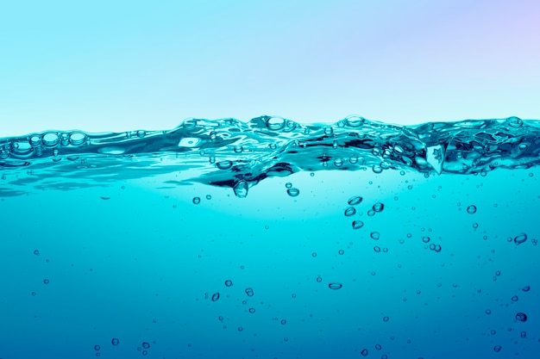
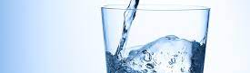
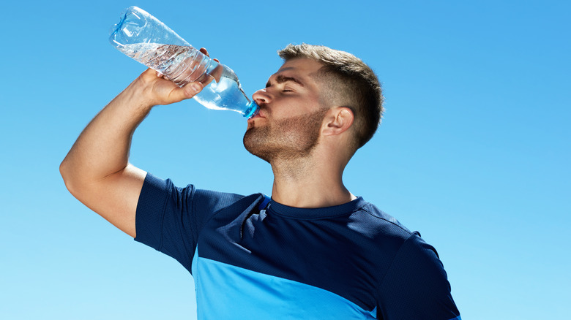
What’s up with Water?
Water Guard: Protecting Ecosystems, One Swim at a Time

Slide 2

Problem Definition:
Our challenge is to develop a user-friendly mobile app that informs users about endangered species in nearby water bodies, educates them on conservation efforts, and bridges the gap between the hidden aquatic world and recreational water activities, fostering a sense of responsibility for the preservation of these ecosystems.

Slide 3
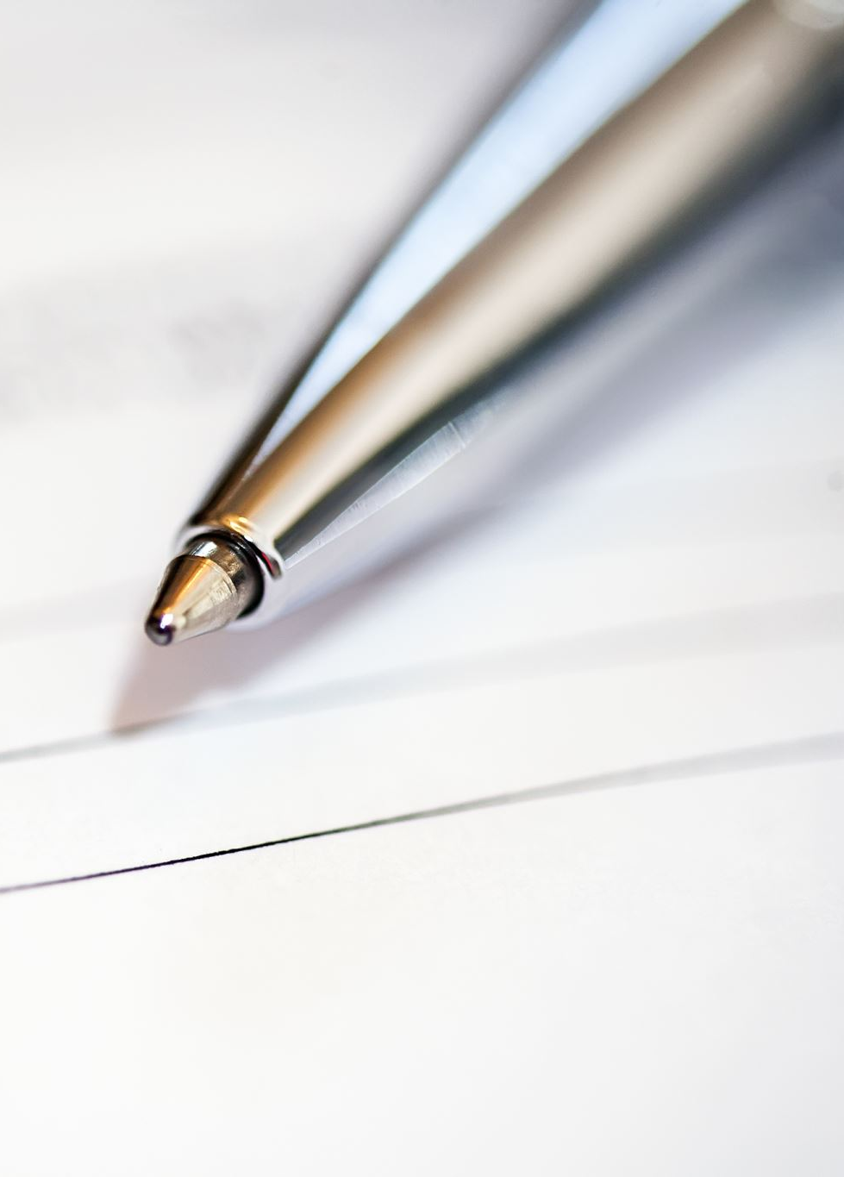


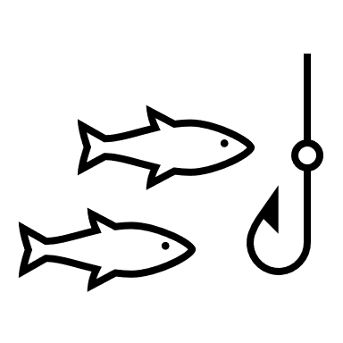


Objectives
1
1
User Friendly Application
2
2
Check water quality
3
3
Endangered species
living in the water
4
4
5
How to protect them?
5
Water source
6
Notes:
Cleanup:
Bioremediation: Utilize natural processes and microorganisms to break down and degrade oil in the environment.
Chemical Dispersants: Consider the controlled use of chemical dispersants to break up large oil slicks into smaller, more manageable droplets.
Manual Cleanup: Mobilize trained personnel to manually clean affected shorelines and wildlife.
Innovative Technologies: Explore innovative technologies, such as autonomous vehicles and drones, to aid in cleanup efforts.

Slide 4
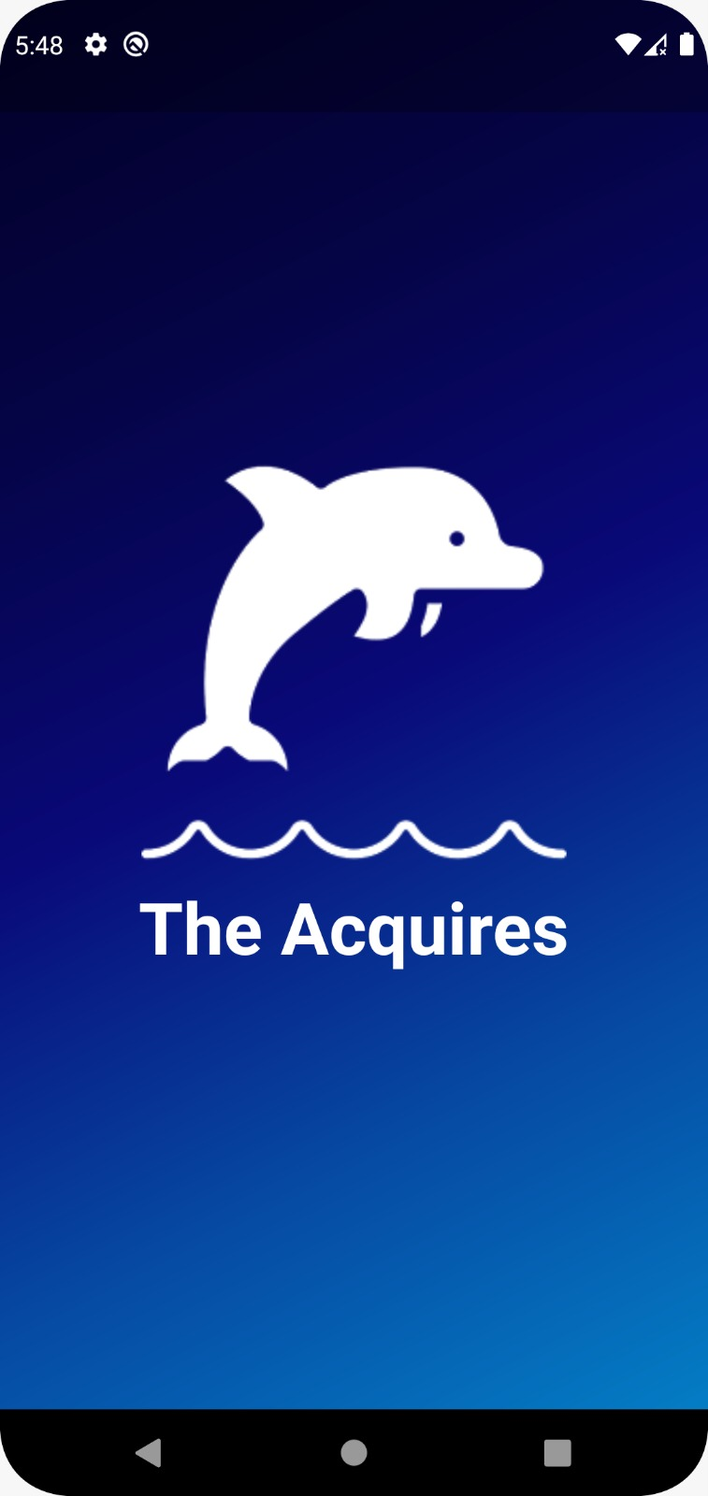
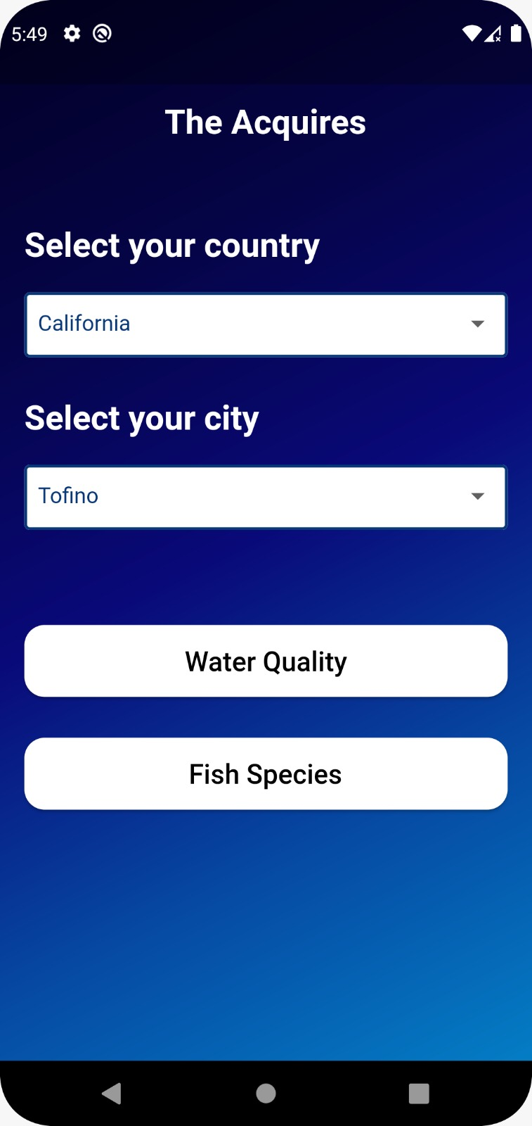
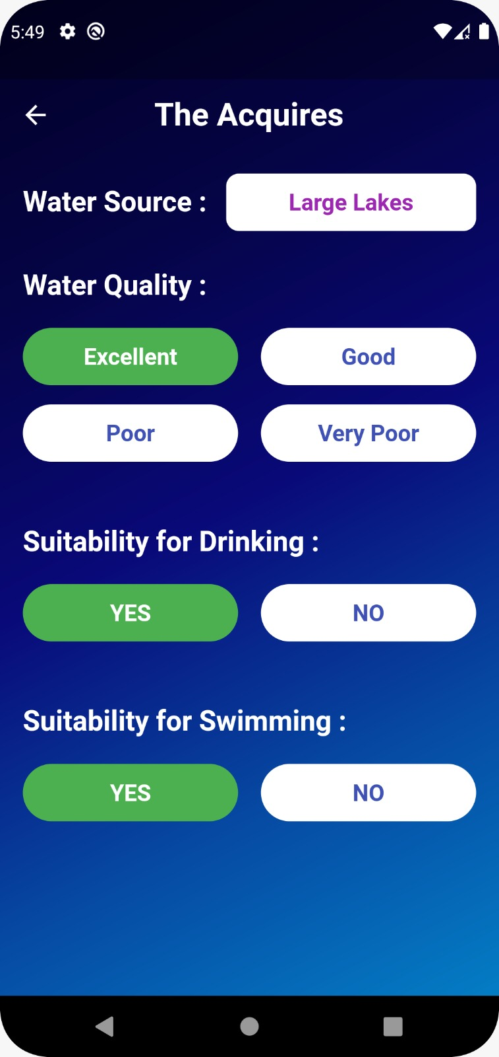
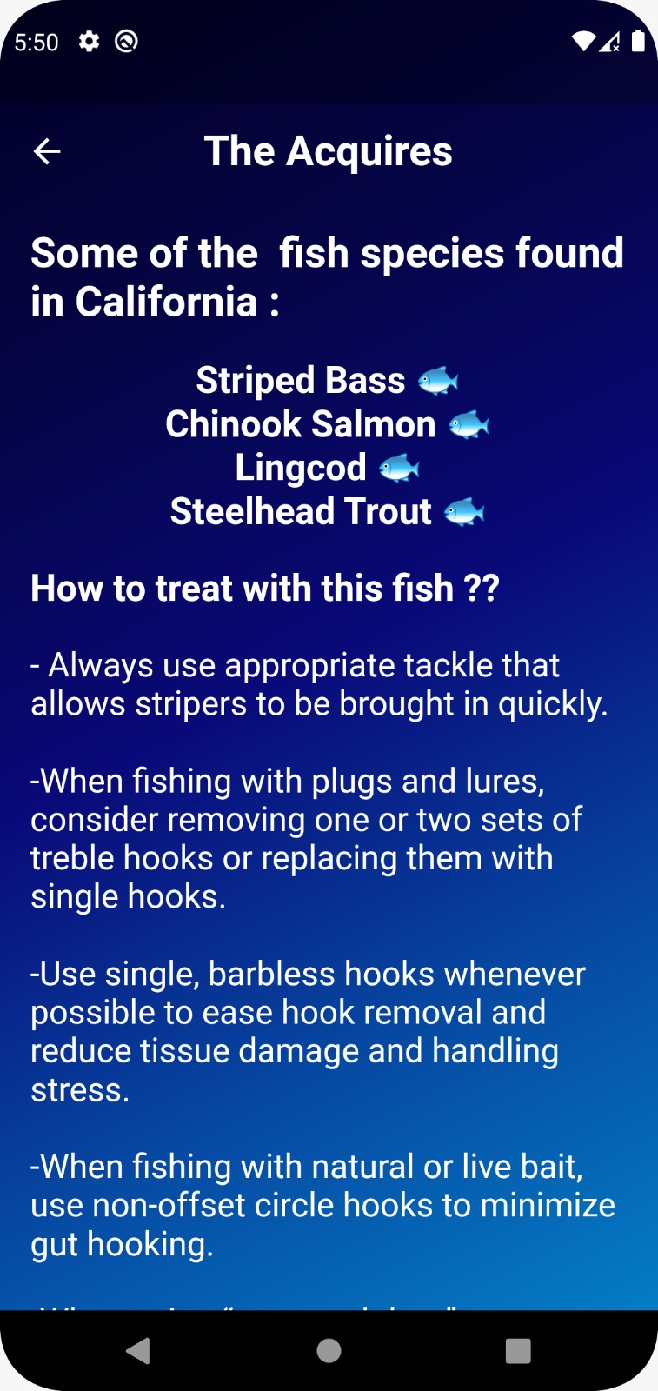

Slide 5
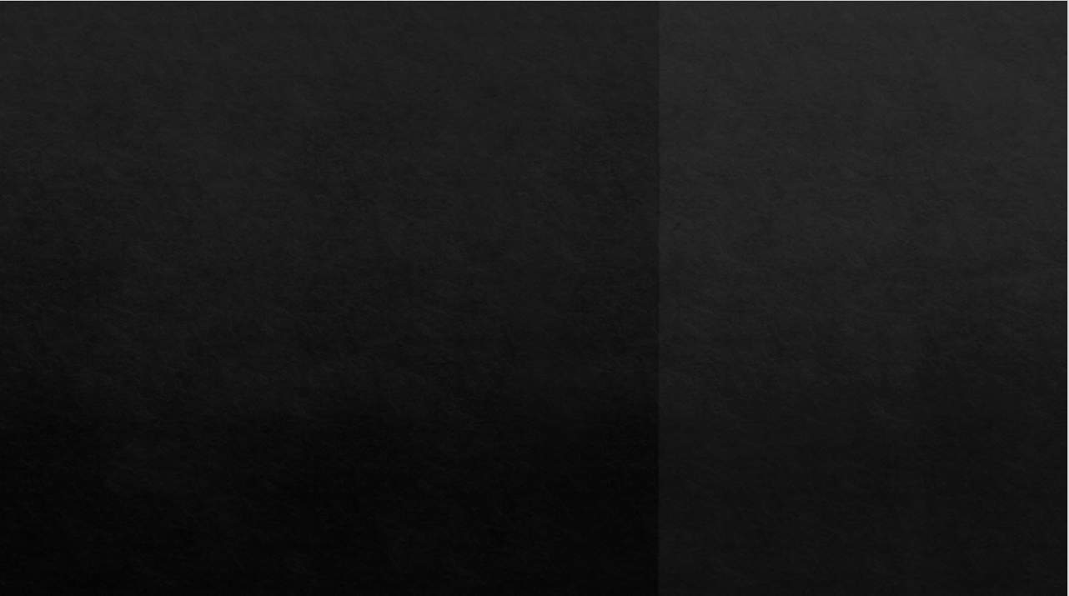
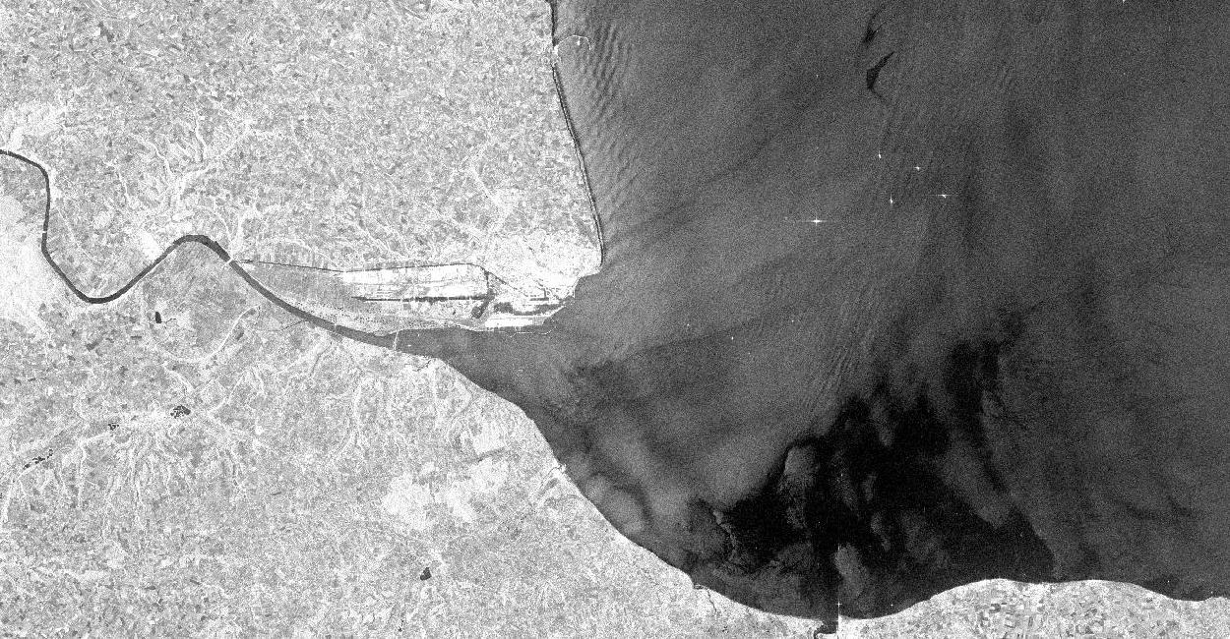
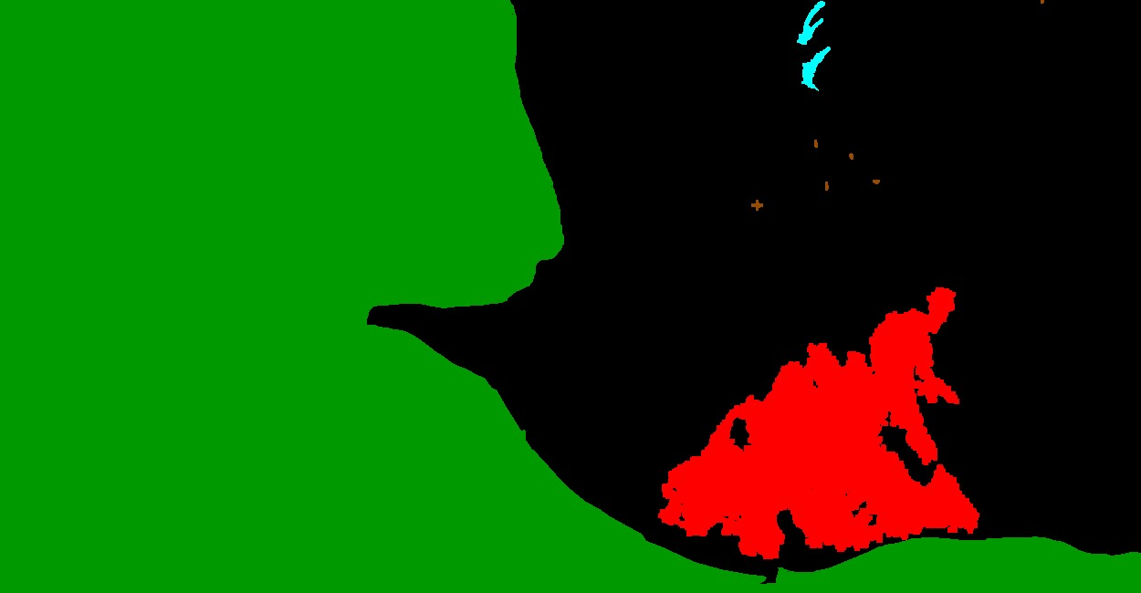
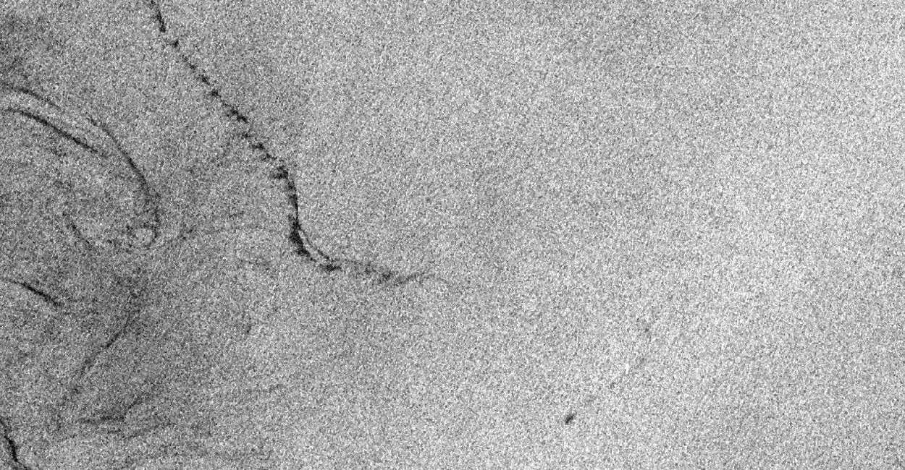
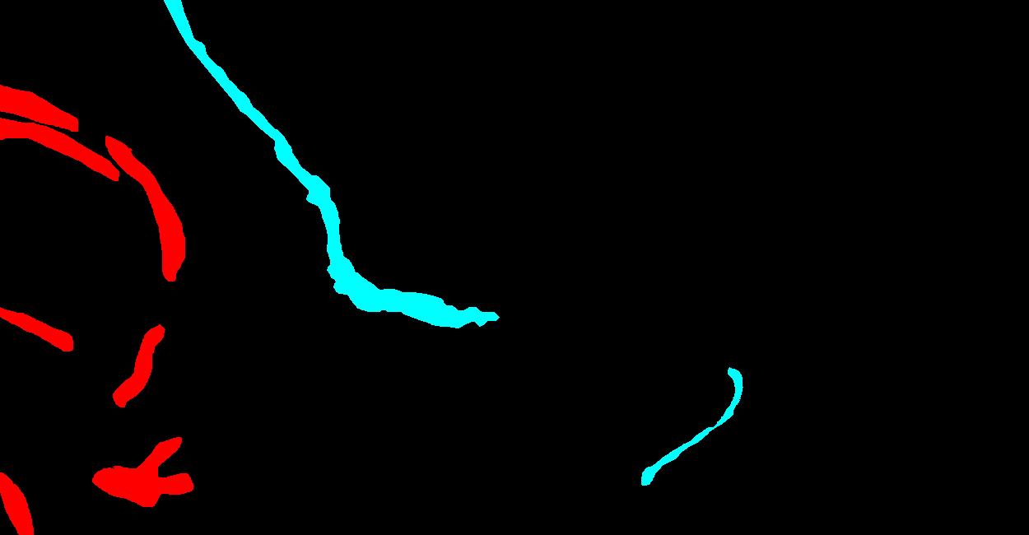
Oil-Spill
Ship
Land
Sea surface
Look a like

Slide 6
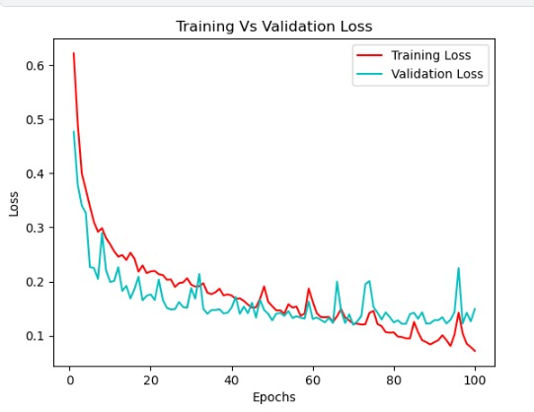
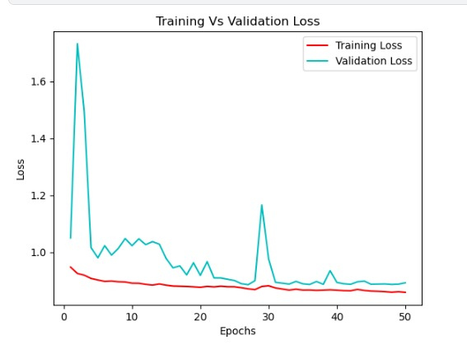
UNET DEEPLABV3
Train accuracy: 97%
Validation accuracy: 96%
Test accuracy: 100%
Train accuracy: 98%
Validation accuracy: 91%
Test accuracy: 95%
Jaccard_coeff accuracy: 91%

Slide 7
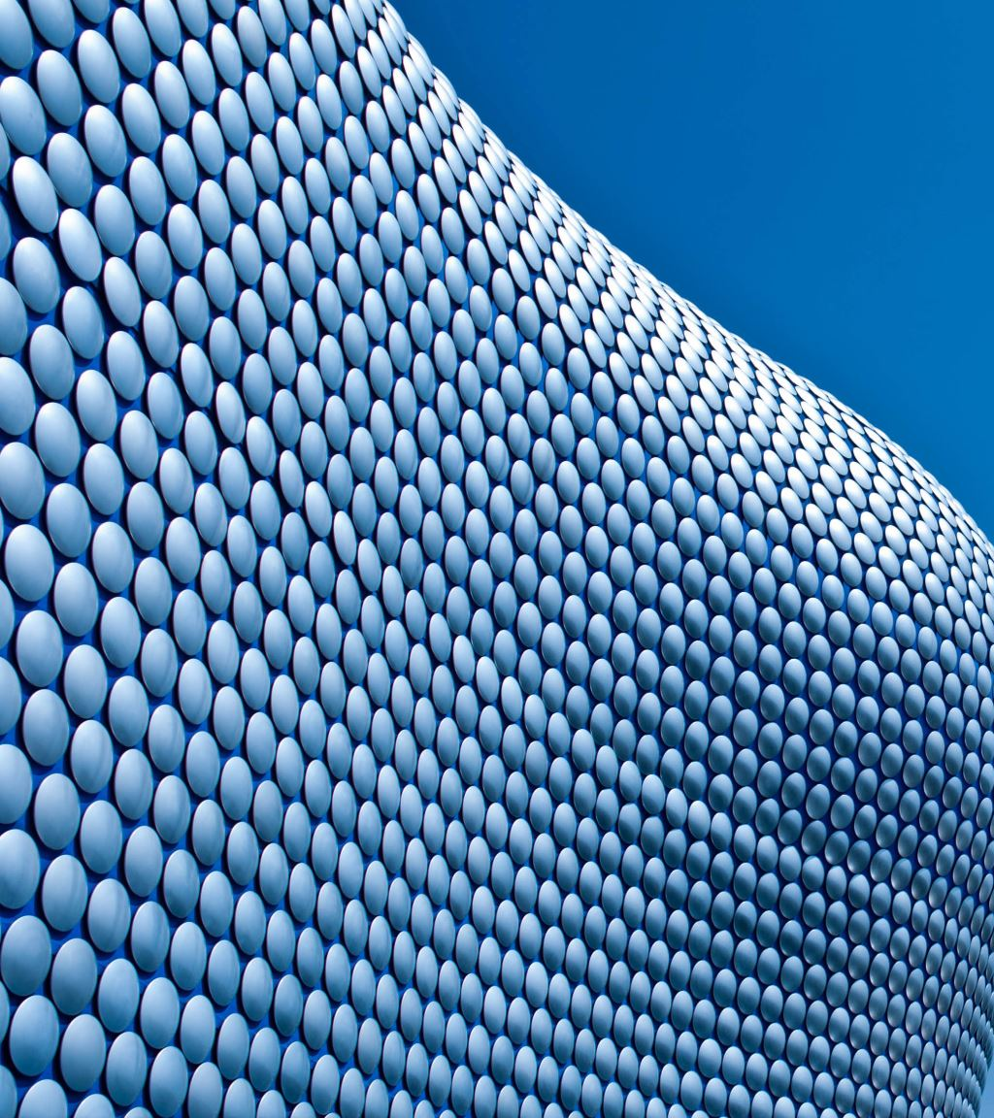
Resources:
NOAA’s water quality portal
Open Data Portal of the Climate Change Initiative
GitHub:
1) python_for_microscopists
2) Semantic-Segmentation-Architecture

